Slide 1
Foot Traffic and Dwell Time Trends at Office Supply Stores During the Remote Work Shift
Analyzing customer visits amid growing remote work adoption
Notes:
AI-generated content may be incorrect. ---

Slide 2
Introduction & Context
Notes:
--- This slide references information from the following file: https://purdue0-my.sharepoint.com/personal/rsana_purdue_edu/_layouts/15/Doc.aspx?sourcedoc=%7BCB5F538E-AD73-4F91-A8F8-8F5817F554D1%7D&file=Group%207_Status_Report%20copy_deck%20reference.docx&action=default&mobileredirect=true Study Overview and Data Sources

Slide 3
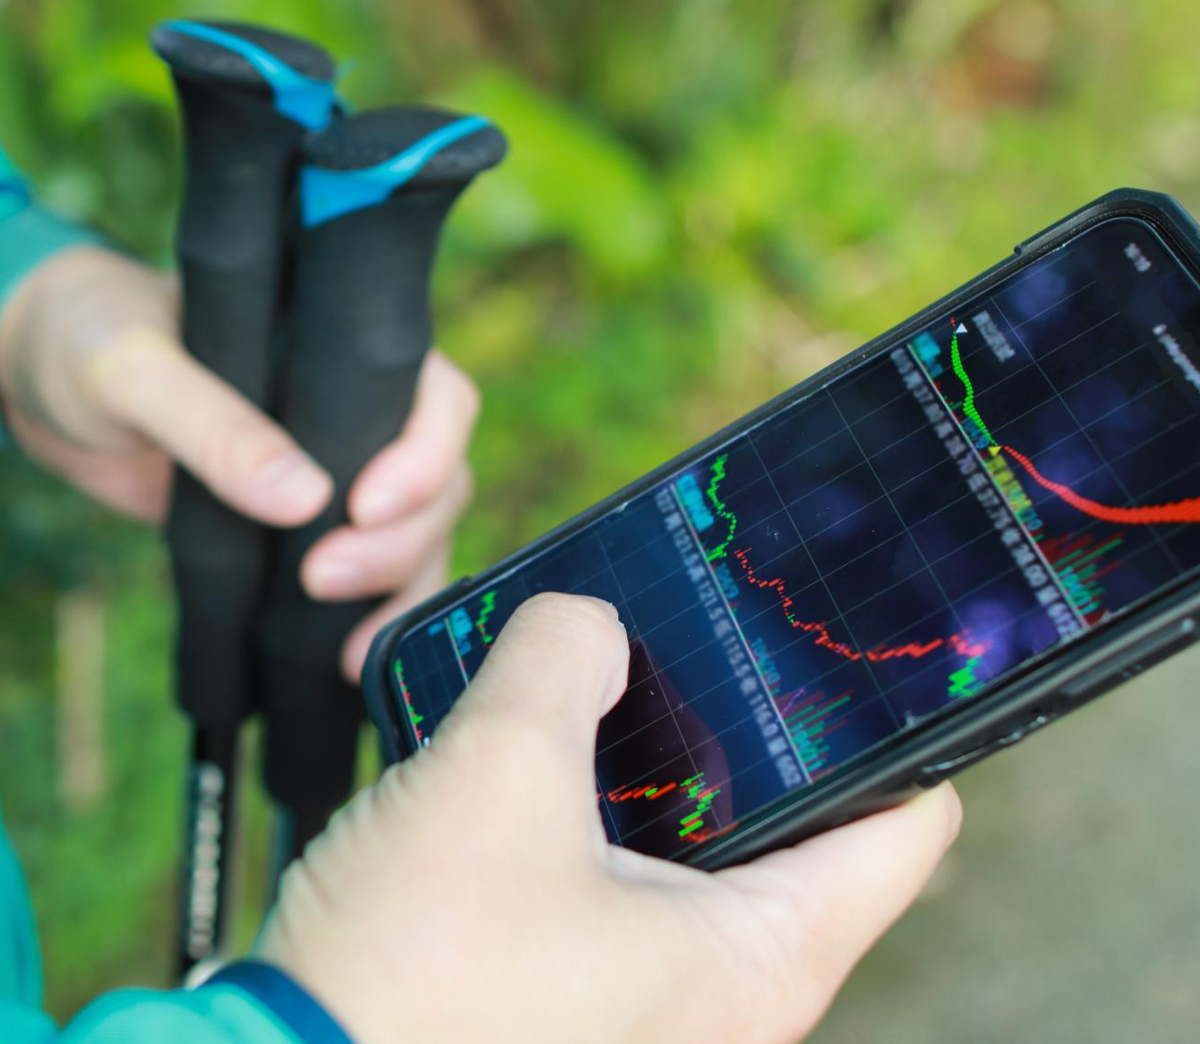
Study Overview and Data Sources
Study Focus and Period
The study examines foot traffic and dwell time trends in office supply stores from January to April 2020 during COVID-19 onset.
Geographic Classification
California counties are classified into urban, suburban, and rural using RUCA codes to analyze consumer behavior shifts by region.
Data Sources and Metrics
Data from SafeGraph provides detailed foot traffic and dwell time metrics, combined with demographic info like education and household density.
Study Objectives
The study aims to reveal patterns in store visits and time spent to understand community responses to remote work and demand shifts.
Notes:
--- This slide references information from the following file: https://purdue0-my.sharepoint.com/personal/rsana_purdue_edu/_layouts/15/Doc.aspx?sourcedoc=%7BCB5F538E-AD73-4F91-A8F8-8F5817F554D1%7D&file=Group%207_Status_Report%20copy_deck%20reference.docx&action=default&mobileredirect=true This study investigates how foot traffic and dwell time trends at office supply stores evolved during the early months of the COVID-19 pandemic, specifically from January to April 2020. The focus is on consumer behavior shifts in California counties, categorized into urban, suburban, and rural regions. The analysis utilizes data from SafeGraph, which provides detailed foot traffic and dwell time metrics, and RUCA codes to classify geographic regions. Additionally, demographic data such as education levels, working-age population, and K–12 household density are incorporated to understand the influence of these factors on store engagement. The study aims to uncover patterns in consumer visits and time spent in stores, offering insights into how different communities responded to the sudden shift to remote work and the increased demand for office supplies.

Slide 4
Research Question 1: Foot Traffic & Demographics
Notes:
--- This slide references information from the following file: https://purdue0-my.sharepoint.com/personal/rsana_purdue_edu/_layouts/15/Doc.aspx?sourcedoc=%7BCB5F538E-AD73-4F91-A8F8-8F5817F554D1%7D&file=Group%207_Status_Report%20copy_deck%20reference.docx&action=default&mobileredirect=true Weekly Trends and Demographic Influences

Slide 5
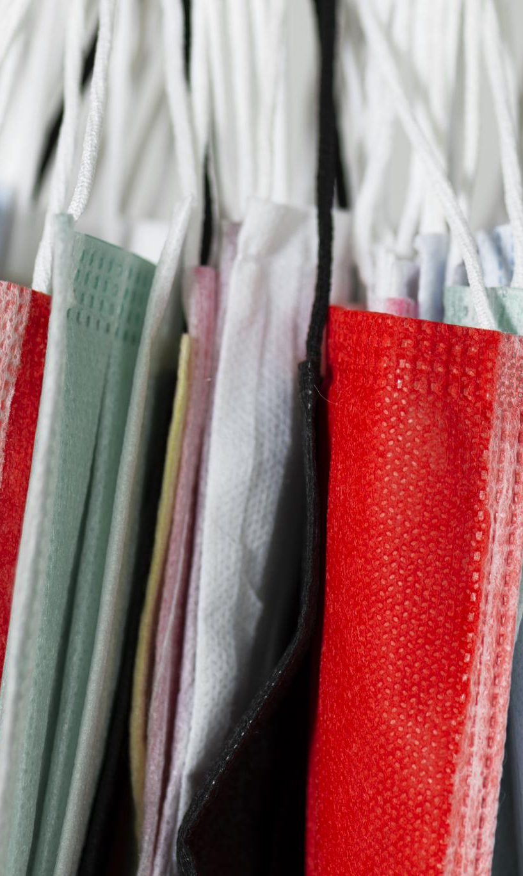
Weekly Trends and Demographic Influences
Foot Traffic Trends
Office supply store visits peaked early 2020, declined sharply mid-March due to lockdowns, then rebounded notably by Week 17.
Specialty Store Behavior
Specialty stores had fewer visits with significantly longer dwell times, indicating focused shopping with high intent.
Demographic Impacts on Visits
K–12 household areas showed increased visits driven by school supply needs; working-age dense counties had shorter shopping times.
Education Level and Shopping
Regions with higher education levels saw longer dwell times, reflecting preference for personalized and boutique shopping experiences.
Notes:
--- This slide references information from the following file: https://purdue0-my.sharepoint.com/personal/rsana_purdue_edu/_layouts/15/Doc.aspx?sourcedoc=%7BCB5F538E-AD73-4F91-A8F8-8F5817F554D1%7D&file=Group%207_Status_Report%20copy_deck%20reference.docx&action=default&mobileredirect=true During the first quarter of 2020, foot traffic at office supply stores peaked in January and February, followed by a sharp decline in mid-March (Week 12) due to lockdowns. Staples demonstrated a notable rebound in Week 17, reaching nearly 98,000 visits, indicating a recovery driven by consumers replenishing home-office supplies. Specialty stores such as Papyrus and Rapid Refill experienced fewer visits but significantly longer dwell times, suggesting high-intent, focused shopping behavior. Demographic factors played a crucial role in these patterns. Areas with a high concentration of K–12 households showed increased visits, likely driven by school-related supply needs. Counties with a dense working-age population exhibited shorter dwell times, reflecting quick, goal-oriented purchases. Additionally, regions with higher education levels, particularly those with a greater number of bachelor’s and master’s degree holders, saw longer dwell times, indicating a preference for personalized and boutique-style shopping experiences.

Slide 6
Research Question 2: Suburban vs Urban Recovery
Notes:
--- This slide references information from the following file: https://purdue0-my.sharepoint.com/personal/rsana_purdue_edu/_layouts/15/Doc.aspx?sourcedoc=%7BCB5F538E-AD73-4F91-A8F8-8F5817F554D1%7D&file=Group%207_Status_Report%20copy_deck%20reference.docx&action=default&mobileredirect=true Geographic Recovery Patterns

Slide 7

Geographic Recovery Patterns
Suburban Recovery Leadership
Suburban counties showed the strongest recovery in office supply store visits during early remote work phases.
Urban Shopping Efficiency
Urban areas had fewer visits but maintained consistent dwell times, indicating efficient shopping behavior.
Rural Leisurely Shopping
Rural shoppers visited less often but spent more time per visit, suggesting a relaxed and exploratory approach.
Regional Demand Variations
Areas like Los Angeles County showed sustained demand, highlighting geographic differences in recovery.
Notes:
--- This slide references information from the following file: https://purdue0-my.sharepoint.com/personal/rsana_purdue_edu/_layouts/15/Doc.aspx?sourcedoc=%7BCB5F538E-AD73-4F91-A8F8-8F5817F554D1%7D&file=Group%207_Status_Report%20copy_deck%20reference.docx&action=default&mobileredirect=true Suburban counties exhibited the strongest recovery in terms of foot traffic and engagement at office supply stores during the early phase of the remote work shift. Staples and Office Depot led this resurgence, benefiting from their strong presence in family-oriented suburban areas. Urban regions, while showing slightly lower visit numbers, maintained similar dwell times, indicating efficient, goal-driven shopping behavior. In contrast, rural areas experienced fewer visits but longer dwell times, suggesting a more leisurely and exploratory shopping approach. Notably, hotspots such as Los Angeles County demonstrated sustained demand for office supplies, highlighting regional variations in consumer adaptation. These findings underscore the importance of geographic context in understanding retail recovery dynamics and suggest that suburban consumers were quicker to respond to remote work needs, driving early in-store activity.

Slide 8
Research Question 3: Brand Stabilization & Loyalty
Notes:
--- This slide references information from the following file: https://purdue0-my.sharepoint.com/personal/rsana_purdue_edu/_layouts/15/Doc.aspx?sourcedoc=%7BCB5F538E-AD73-4F91-A8F8-8F5817F554D1%7D&file=Group%207_Status_Report%20copy_deck%20reference.docx&action=default&mobileredirect=true Brand Performance and Consumer Behavior

Slide 9
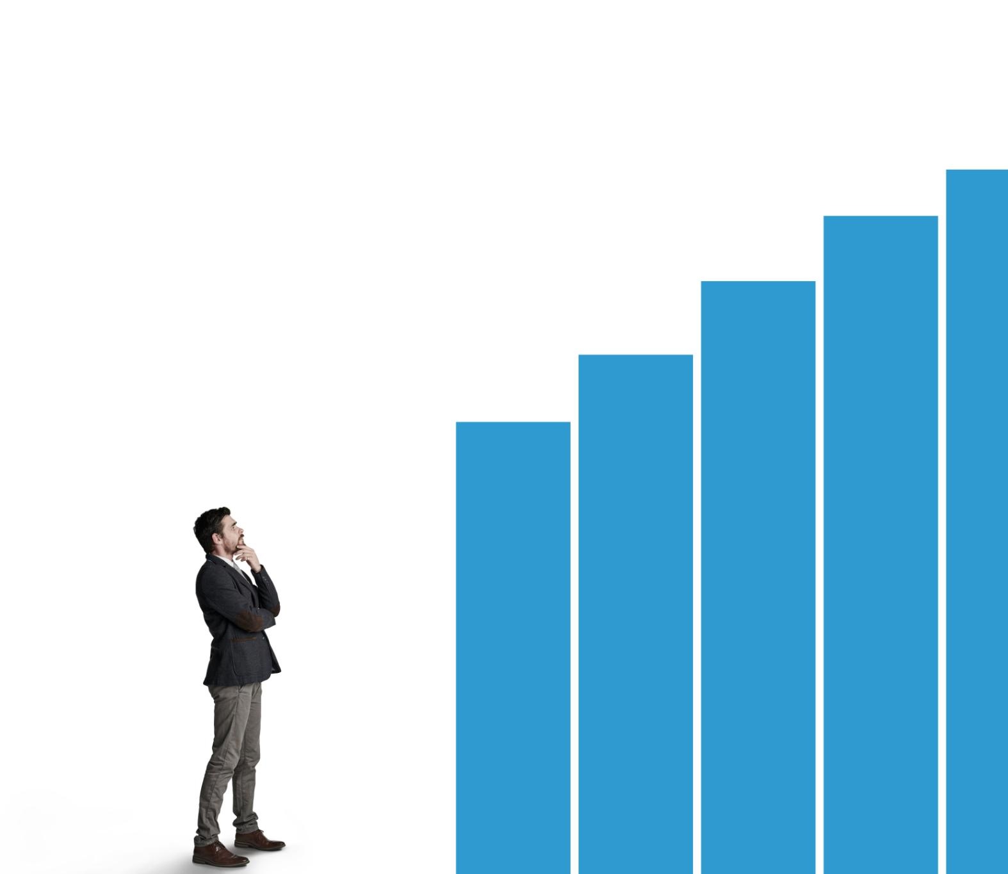
Brand Performance and Consumer Behavior
Brand Stabilization Leaders
Staples and Office Depot led brand stabilization with strong recovery and consumer loyalty during early 2020.
Slower Rebound Challenges
OfficeMax faced slower recovery due to brand overlap and diluted consumer traffic compared to competitors.
Niche Brand Engagement
Specialty brands like Papyrus showed low traffic but high engagement, indicating loyal niche audiences.
Supply Chain and Location Advantage
Reliable supply chains and suburban presence helped brands meet remote workers’ needs effectively.
Notes:
--- This slide references information from the following file: https://purdue0-my.sharepoint.com/personal/rsana_purdue_edu/_layouts/15/Doc.aspx?sourcedoc=%7BCB5F538E-AD73-4F91-A8F8-8F5817F554D1%7D&file=Group%207_Status_Report%20copy_deck%20reference.docx&action=default&mobileredirect=true Staples and Office Depot emerged as leaders in brand stabilization during the first four months of 2020. Staples showed a rapid rebound in Week 17, with visits increasing from 47,000 to 98,000, reflecting strong brand loyalty and its perception as an essential retailer. Office Depot followed with a steady recovery, while OfficeMax experienced a slower rebound, possibly due to brand overlap and diluted traffic. Specialty brands like Papyrus and Rapid Refill maintained low traffic volumes but exhibited high dwell times, indicating deep engagement from a niche audience. These patterns suggest that essential status and consumer trust played significant roles in early recovery. Brands with reliable supply chains and strong suburban footprints were better positioned to meet the immediate needs of remote workers, reinforcing their importance in the evolving retail landscape.

Slide 10
Overall Conclusions
Notes:
--- This slide references information from the following file: https://purdue0-my.sharepoint.com/personal/rsana_purdue_edu/_layouts/15/Doc.aspx?sourcedoc=%7BCB5F538E-AD73-4F91-A8F8-8F5817F554D1%7D&file=Group%207_Status_Report%20copy_deck%20reference.docx&action=default&mobileredirect=true Summary of Insights and Strategic Implications

Slide 11
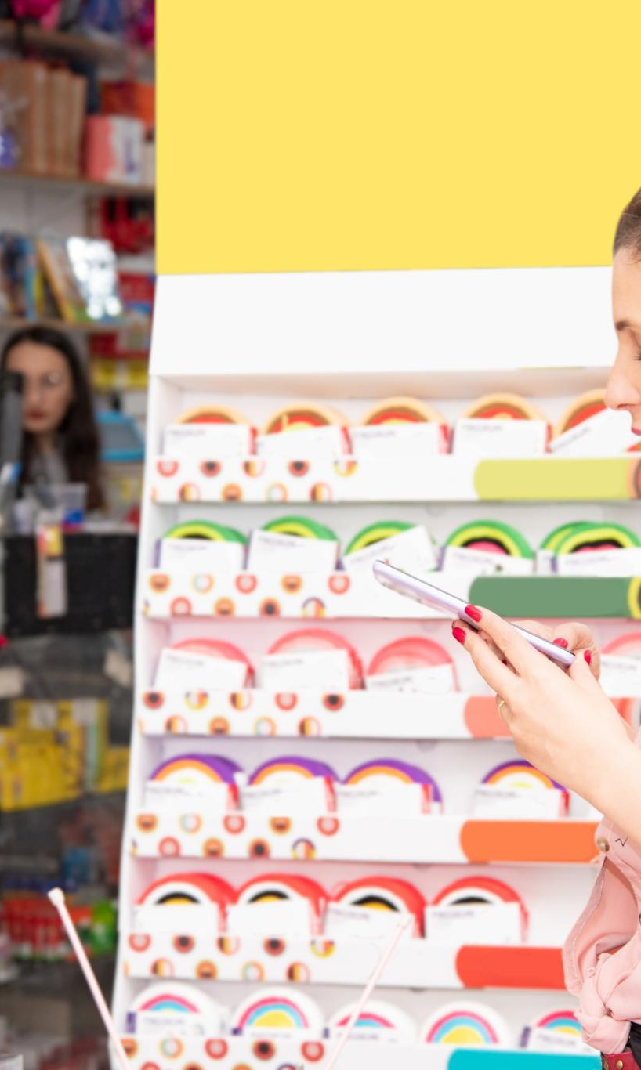
Summary of Insights and Strategic Implications
Suburban Consumer Adaptation
Suburban consumers quickly adapted to remote work, boosting foot traffic and dwell time at office supply stores.
Brand Loyalty Impact
Staples and Office Depot leveraged essential status and strong brand loyalty to lead the retail resurgence.
Demographic Influence on Behavior
Household composition, working-age density, and education levels shaped efficiency-driven and experience-driven consumer behavior.
Retail Strategic Tailoring
Retailers can tailor strategies by creating concept stores in educated areas and enhancing convenience in suburbs.
Notes:
--- This slide references information from the following file: https://purdue0-my.sharepoint.com/personal/rsana_purdue_edu/_layouts/15/Doc.aspx?sourcedoc=%7BCB5F538E-AD73-4F91-A8F8-8F5817F554D1%7D&file=Group%207_Status_Report%20copy_deck%20reference.docx&action=default&mobileredirect=true The study concludes that suburban consumers adapted more quickly to remote work demands, leading to a faster recovery in foot traffic and dwell times at office supply stores. Staples and Office Depot capitalized on their essential status and strong brand loyalty to lead this resurgence. Demographic factors such as household composition, working-age density, and education levels significantly influenced shopping behavior, creating a divide between efficiency-driven and experience-driven consumers. Retailers can leverage these insights to tailor their strategies, such as developing concept stores in highly educated areas or enhancing convenience in suburban locations. Understanding these behavioral shifts is crucial for navigating post-pandemic retail dynamics and aligning offerings with evolving consumer needs.

